Slide 1
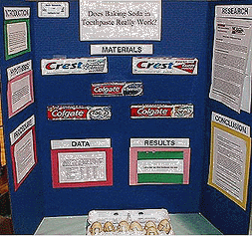
The Display Board
http://mset.rst2.edu/portfolios/l/lautz_s/Science%20Fair%20Handbook/displayboard.html

Slide 2
When you plan your science fair board, remember this is a case in which you CAN judge a book by its cover. If you do a really good job at completing your display, everyone will stop to look at your project. However, if you do a messy job, no one will take the time to discover all the fascinating research you have done or look at the results of your wonderful experiment.

Slide 3
PLAN YOUR BOARD:
Make a small sketch of where everything will go. Lay it out before you glue anything down to make sure it looks good.
Design what the "center" of your board will be. This is where everyone will look first. Will it be the title or pictures? Everything else should be place around this.
When you set up your board, put things together in an order that makes sense. Remember, we read from left to right so don't put stuff you did near the end (like the conclusion) on the right side of the board.

Slide 4
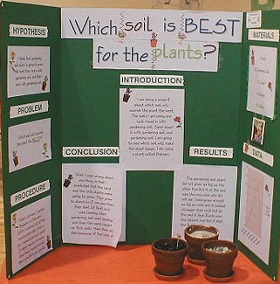

Slide 5
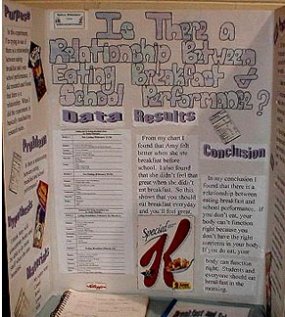

Slide 6
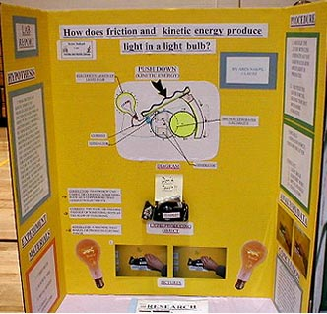

Slide 7
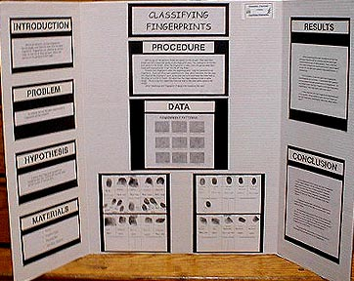

Slide 8
Components of a Good Display Title Statement of Purpose/Question Research (Brief summaries of information) Hypothesis Materials Procedure Data Table and Charts Analysis and Conclusion Applications and Errors

Slide 9
COLORS AND TEXT: 1. Try using a different font or color for each of the labels. 2. Use colors that are appealing. They should contrast with your board color. If you have a white board, make your text a bright color(s). Try backing your text with colored paper to make your words alive. 3. Type your text or print it neatly. Use stencils or premade letters if you prefer. Make your lettering large enough for everyone to see. If you print it, use pencil first and draw guidelines to make sure your writing is neat. Go over your writing with permanent marker and make sure you erase your guidelines.

Slide 10
DISPLAY YOUR DATA: You may display your data in a table or graph. Make sure your graph reflects the kind of data you have collected. • A line graph demonstrates change over time. • A bar/picture graph demonstrates a comparison between two or more things. • A circle/pie graph compares parts to the whole. Graphs and tables should be neatly done. Use computer generated graphs and tables or make them yourself. Use a ruler and colored pencils or markers to make them really eye appealing.

Slide 11
ILLUSTRATIONS: Sometimes your results can be shown by photographs or pictures. Photographs and pictures also enhance a display, especially if you don't have the actual experiment because you used something that can't be displayed (i.e. pets, family members). You may also use computer generated graphics or photographs off the internet. Before using any Internet pictures Check to see if you have permission to use them.

Slide 12
FINISHING TOUCHES:
• Make sure you proofread all your written work.
• Use rulers to keep the display even
Don't use pencils. It looks unfinished.
Carefully glue down your paper and letters—glue sticks make a neater appearance
• Erase all pencil guidelines.

Slide 13
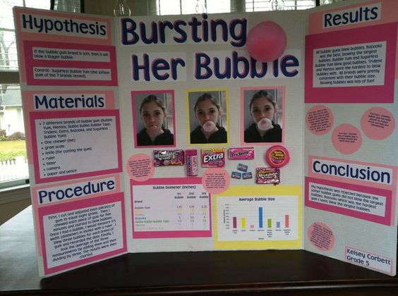

Slide 16
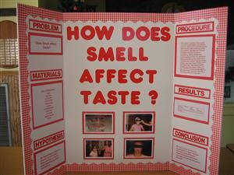

Slide 17
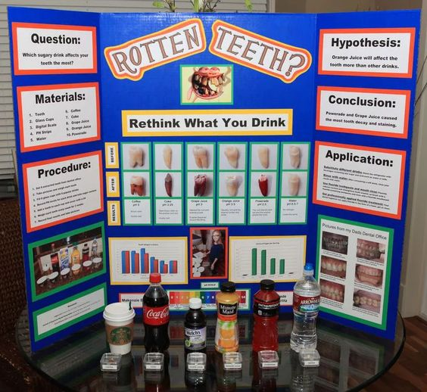

Slide 19
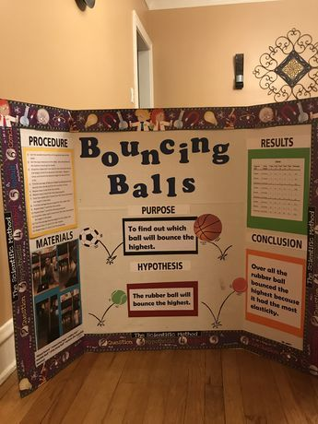

Slide 20
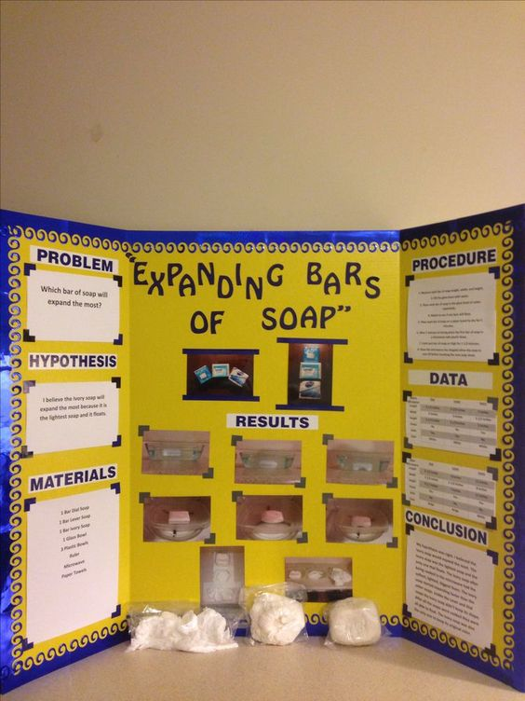

Slide 23
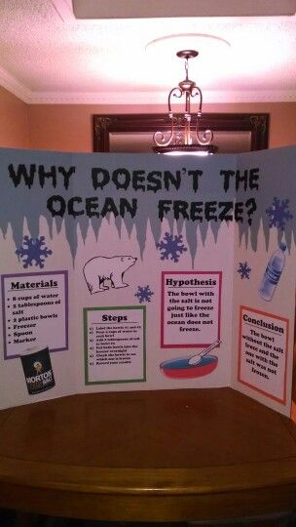

Slide 24
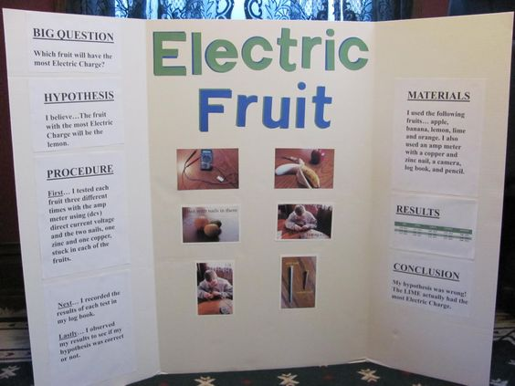

Slide 25
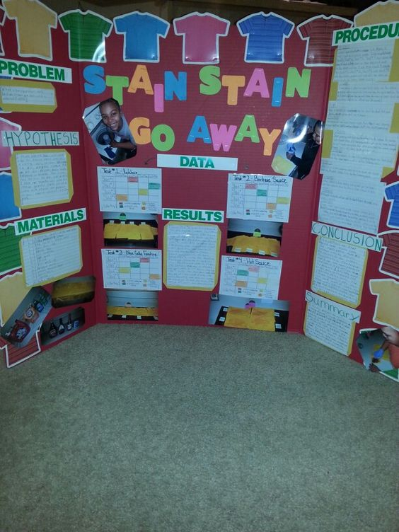

Slide 26
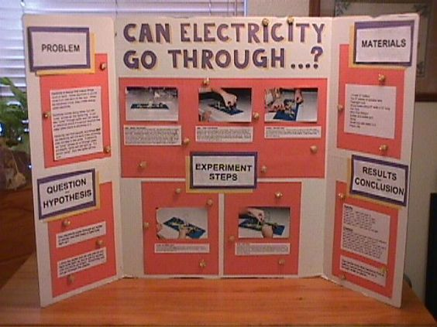

Slide 27
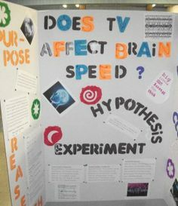

Slide 28
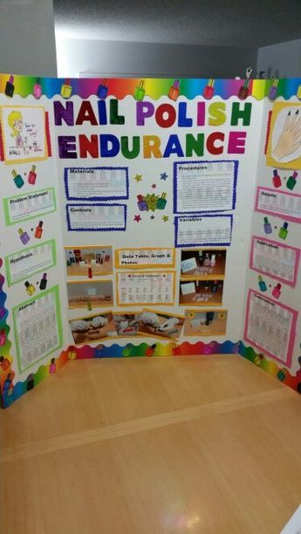

Slide 29
